Slide 1
Figure 1. Analytic pipeline of homoeolog gene expression and co-expression networks.
in silico polyploid ADs
RNA-seq Data
GSNAP-PolyCat
Bowtie2-HyLite
Bowtie2-RSEM
Read Mapping
rlog
RPKM
Normalization
DESeq
EBSeq
Differential Expression
Pearson’s correlation with Fisher’s Z statistic
Differential Co-expression
Ranking cutoff
Z score cutoff
WGCNA
Network Construction
Node connectivity
Module Membership
Functional connectivity
Topology Assessment

Slide 2

Dynamics of Duplicated Networks in Polyploids
Guanjing Hu
May 12th, 2017
Wendel Lab
@

Slide 3
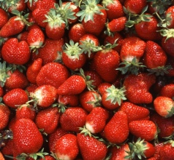

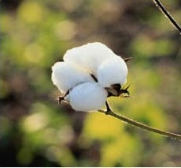




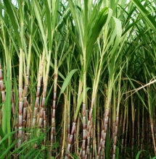







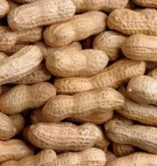
Polyploidy.
Polyploidy is a widespread phenomenon throughout eukaryotes, with important ecological and evolutionary consequences:
Gain and loss of duplicated genes
Biased sub-genome fractionation
Epigenomic modifications
Expression changes
…
Notes:
gainPolypoidy or WGD is a well-known phenomenon throughout eukayote, and it is especially difﬁcult to overstate its importance to modern plant species
We already know that all ﬂowering plants have experienced multiple rounds of polyploidy at some point in their ancestry and that it remains an active evolutionary and ecological process in many lineages (Jiao 2011)
Underlying the vast biological diversity and morphology, the consequences of polyploidy have been evaluated for a number of model systems, and from different perspectives like gain and loss of duplicated genes, biased genome fractionation and epigenetic modifications, as well as variable types of expression changes.

Slide 4
Network Evolution.
Ancestral Network
Genome
Duplication
Genetic duplication reshapes the architecture of biological networks, and sets in motion the evolutionary changes of network components and regulatory interactions, which ultimately affects how molecules generate morphological phenotypes.
Fully
Redundant
Network
Node Loss
Edge loss and gain
Extant
Network
Modified from Gavin C. Conant, Proc. R. Soc. B 2010
Notes:
As every organism achieve form and function through an intricate web of regulatory relationships between DNA, RNA, proteins and metabolites, we can consider polyploidy as a duplication of biological networks, the resulted fully redundant network is later modified by a series of changes on network components and relationships.

Slide 5
Network-based
inference of function and phenotype
Rhee&Mutwil, Trend Plant Science 2014
Notes:
Network analysis has also become a powerful method for revealing the architecture that underlies the genotype to phenotype equation, the topic of this meeting.
I don’t have time to detail the various kinds of data sets and methods involved, but I do wish to explore with you today one example, using [click]

Slide 6
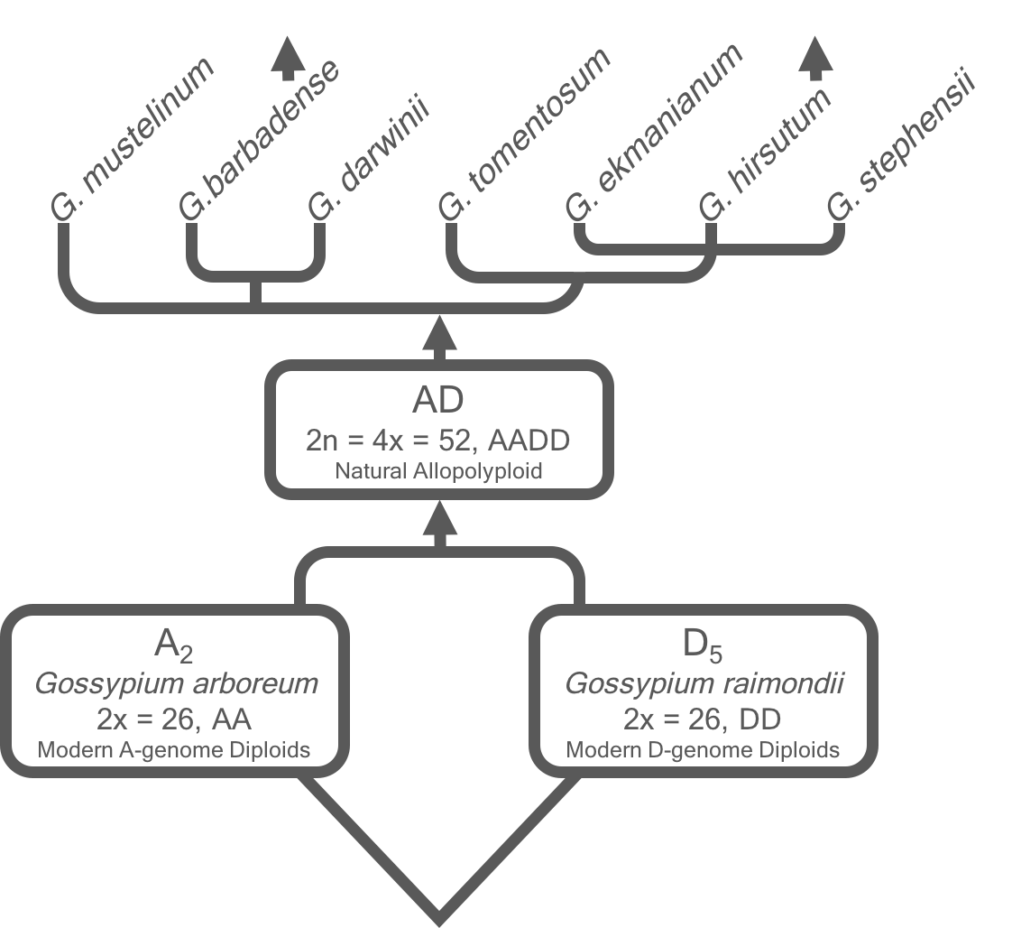

Cotton
model of polyploid evolution
Domestication (6000 ya)
Polyploid diversification (~1.5 mya)
Allopolyploidization (1-2 mya)
Diploid diversification (5-10 mya)

Slide 7
Presentation
content
Seed development and oil accumulation
How-to and limitations
Topological dynamics by allopolyploidization
Evolutionary dynamics of co-expression network
Construction of duplicated gene networks
Evolution of duplicated gene network
Notes:
I will first talk about our co-expression network analysis focused on cotton seed development and oil accumulation, and then move on to the construction of duplicated gene networks, and finally applying what we have learned to study the dynamics of allopolyploid gene networks.
… hoping to demonstrates how network inference informs our understanding of phenotypic variation that is associated with temporal scales ranging from thousands (domestication) to millions (speciation) of years, and by polyploidy.
And
caveat of our study is that the allopolyploid gene networks were based on the aggregated expression of homoeologous gene pairs.
Further analyses dissecting the interaction or
distinctness of homoeologous modules and networks in polyploid
species will ultimately provide insight into the interaction
among genomes, homoeolog usage in the network, and the
interdependencies of duplicated gene pathways following
polyploidization.

Slide 8
Evolutionary conservation and divergence of gene co-expression networks in Gossypium (cotton) seeds
Notes:
Dynamics of co-expression network of seed development

Slide 9
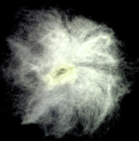
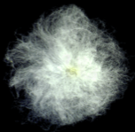
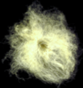
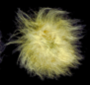
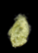
Seed phenotype
oil accumulation
Diploid
Polyploid
% oil content
A₂
AD₁ Yuc
AD₁ TM1
domesticated
D₅
AD₃
days post anthesis
Notes:
Cotton is best known as an important source of textile fibers; however, cotton seeds also provides vegetable oil and proteins, accounting for 10-15% of its total crop values. During the course of seed development in domesticated form of AD1, oil content accumulates rapidly from 20 day to 30 days after flowering, and reaches approximately 25% of total seed weight. This profile is more similar to its D-genome than A-genome progenitor. Variance can also be seen between wild and domesticated cotton.

Slide 10
Co-expression
multispecies network
Hu et al, Genome Biol. Evol. 2017
Notes:
To investigate the underlying transcriptomic achitechure, we first applied WGCNA to construct a multispecies network. Gene within similar expression patterns were clustered together into modules, which indicate “potential” functional association between module members. This modular structure allows us to focus on co-expression genes most relevant to traits of interest.

Slide 11
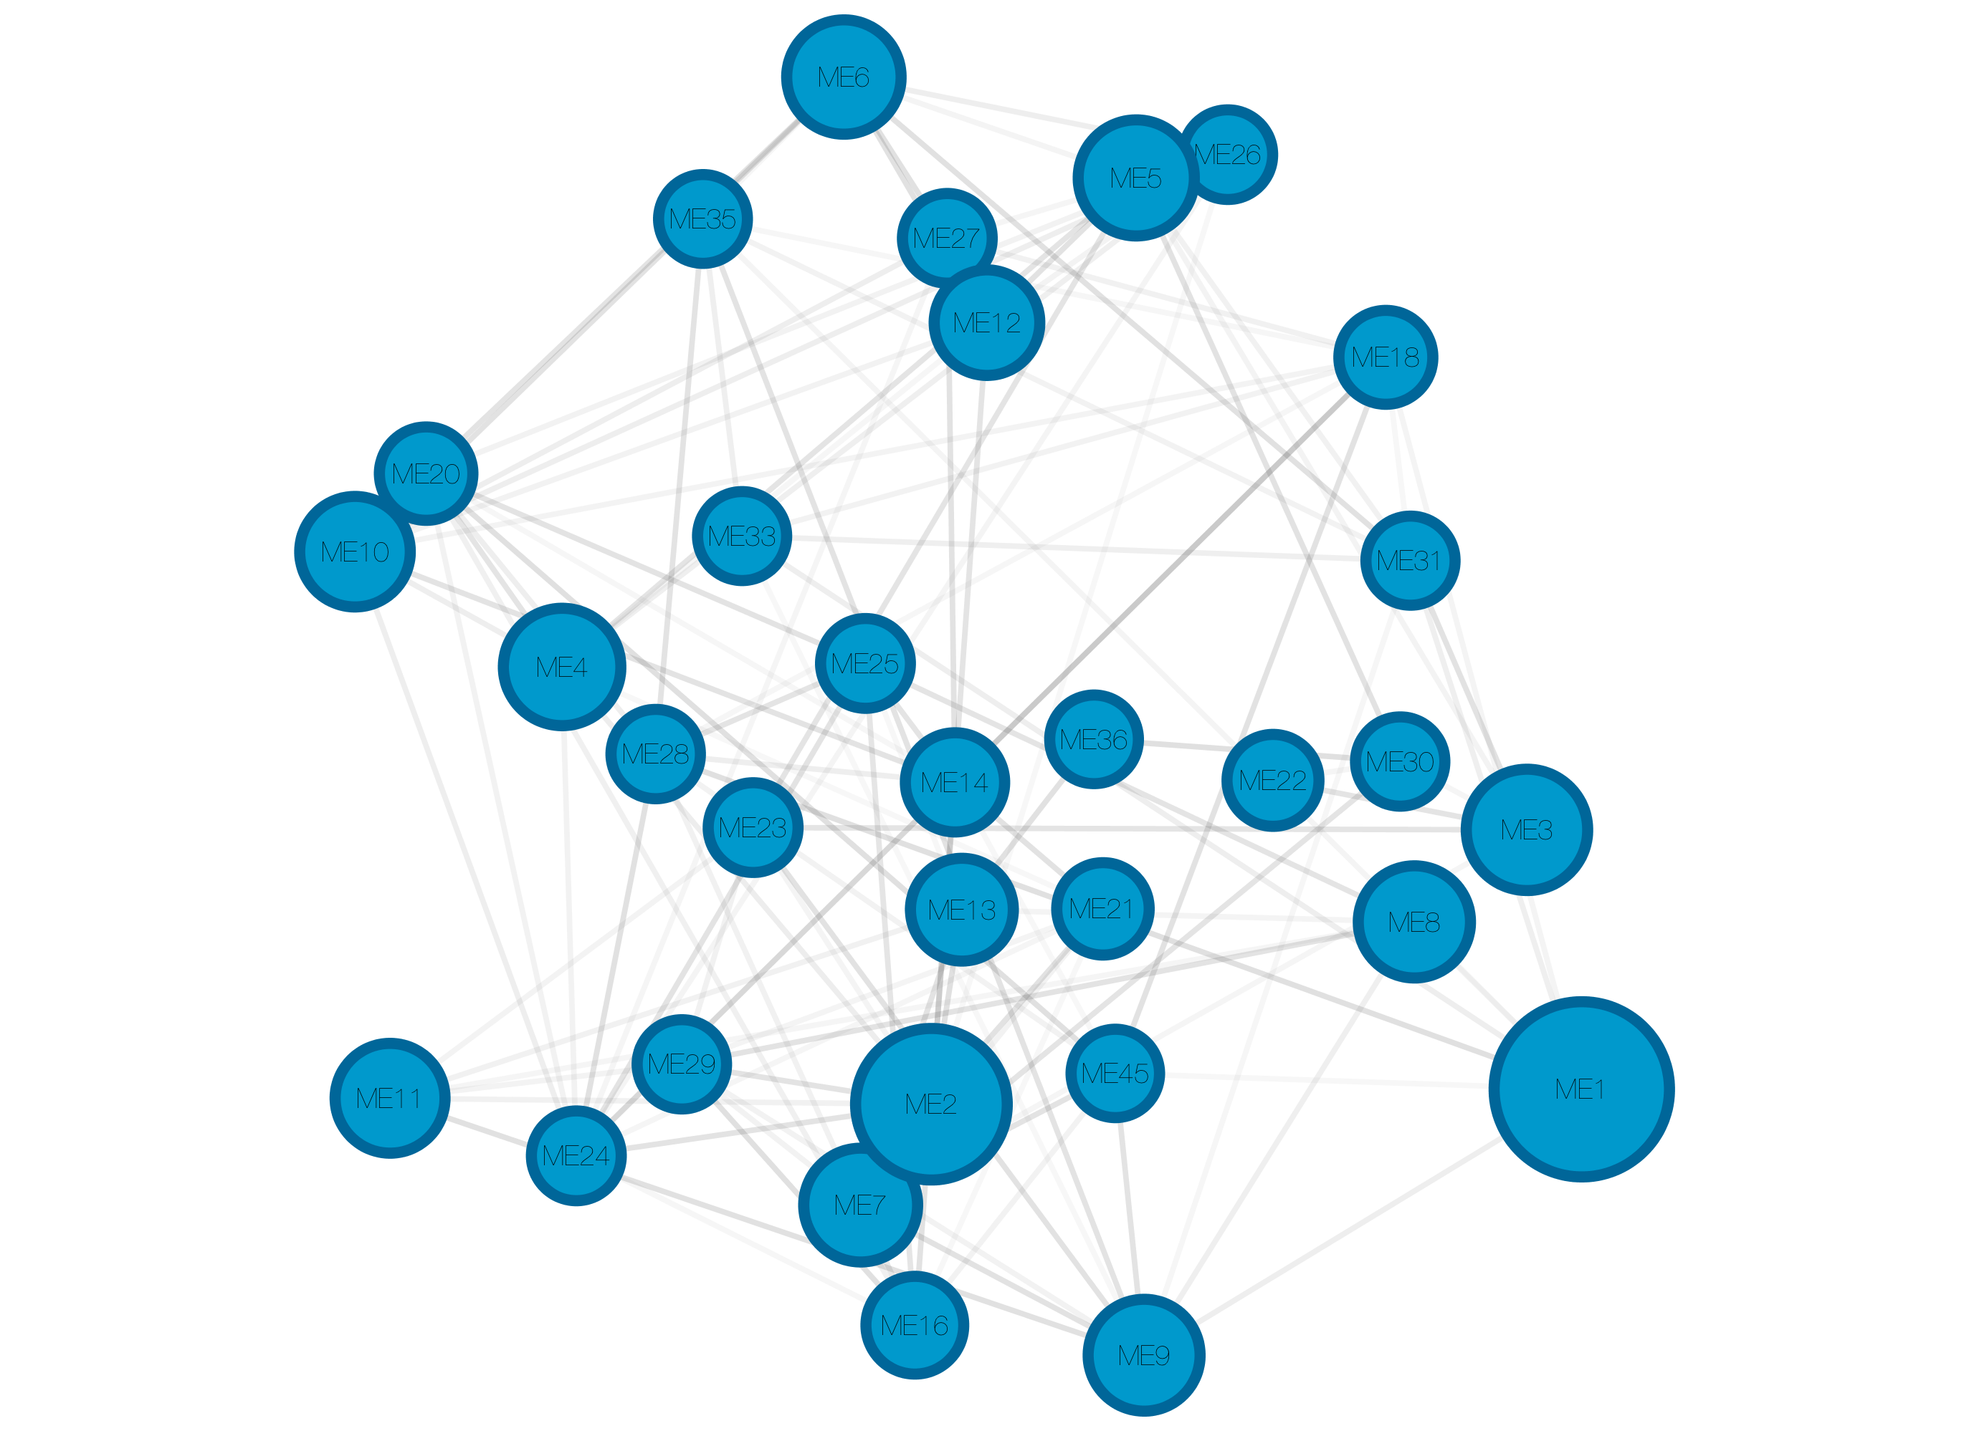
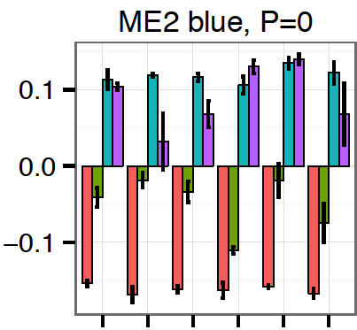
Co-expression
multispecies network
Functional enrichment
storage protein;
oil storage and fatty acid desaturation;
transcripton associated with fatty acid and triacylglycerol biosynthesis;
tissue specification (e.g., growth factor activity, organ specification, and organ boundary formation);
secondary metabolism (e.g., terpene
metabolic process and synthase activity), oxidative homeostasis (e.g., limonene monooxygenase activity);
signal transduction, and regulation.
/
ME2 blue, N=4167
A₂
D₅
Syn
TM1
AD₃
Yuc
Notes:
For example, the blue module displayed peak expression at 30 dpa in all cotton species, is most relevant to oil contents, it is enriched of cellular functions like …
The functional annotation of network modules allows us to examine interconectting module gene members for functional implications.

Slide 12
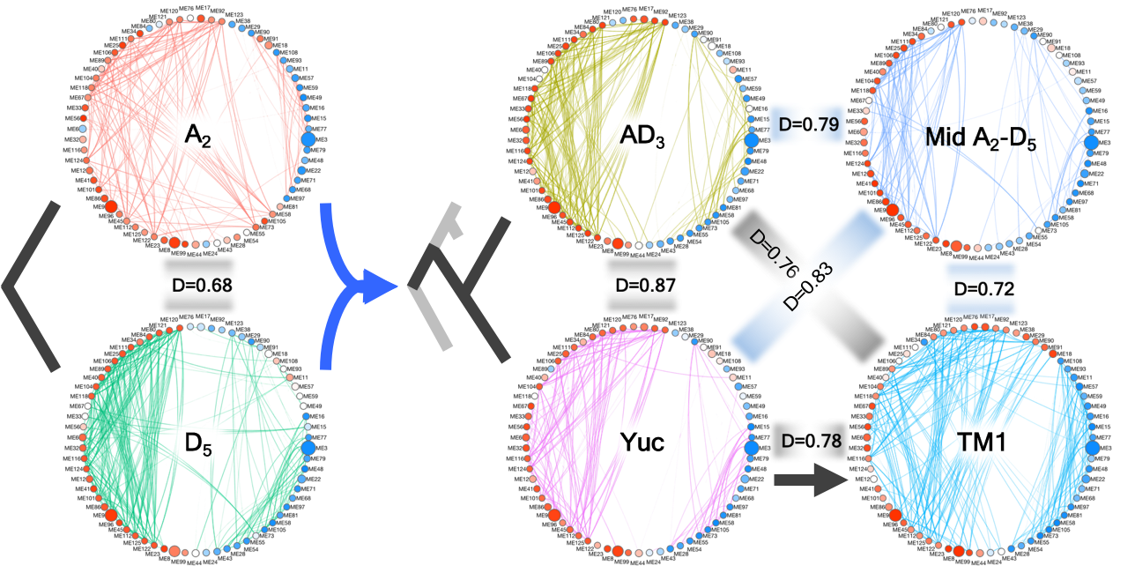
Co-expression
individual network
Cross-genome comparison of seed development networks reveals strong preservation of intra-modular characteristics while active modification of inter-modular relationships in response to evolutionary events.
diploid ancestor
5-10 mya
Polyploidization
1-2 mya
Domestication
5-10 ka
Domesticated G. hirsutum TM1 resembles A- more than D- progenitors (D_{A}= 0. 74, D_{D}=0.67; D_{A}>D_{D}, P<0.05)
Hu et al, Genome Biol. Evol. 2017
Notes:
In addition to multispecies network, we also constructed individual species co-expression network for comparison. Nodes of consensus modules and edges of intermodular realtionships are shown here in circular networks. We use D values to measure the conservation of inter-modular relationships between networks. As we can see, the inter-modular relationships are more similar between two wild polyploid species than the two diploid species. And interestingly, this type of topology was changed more by domesticated than polyploid species.

Slide 13
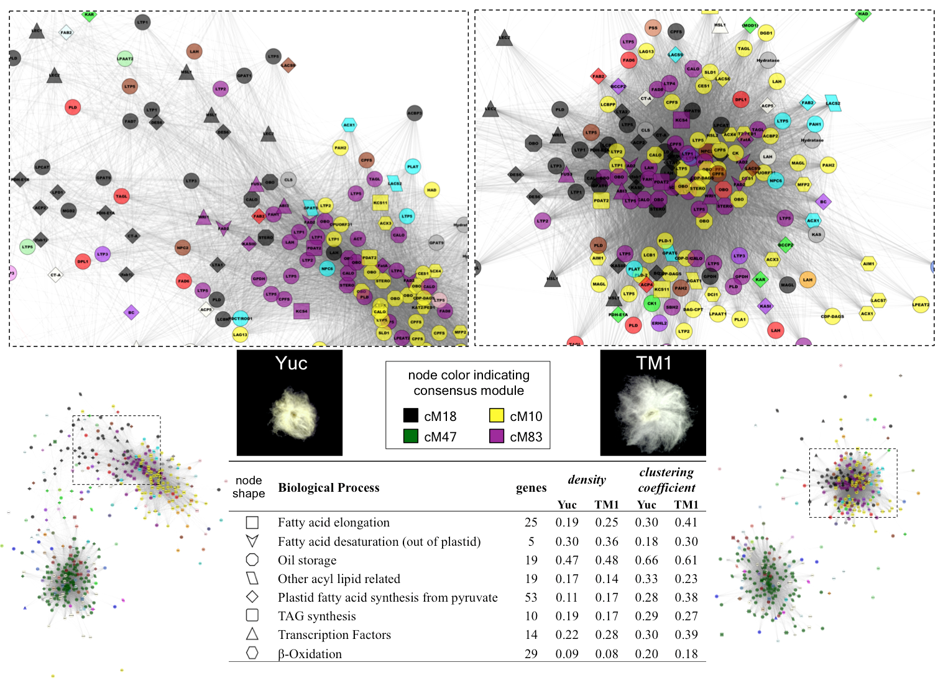
Co-expression
oil synthesis and lipid related gene network
Regulatory connections of oil synthesis-related pathways are denser and more closely clustered in domesticated vs. wild G. hirsutum, suggesting oil synthesis related gene network was altered by domestication
Wild
Domesticated
Hu et al, Genome Biol. Evol. 2017
Notes:
To further investigate the topological changes by domestication, we focus on the sub network including oil synthesis and lipid realted genes

Slide 14
Challenges and pitfalls in the use of partitioned gene counts for homoeologous gene expression and co-expression network analyses

Slide 15
Homoeolog-specific reads
characterization and partition
Ploidy
Ortholog and homoeolog gene sequence
Genome Distinguishing SNP
Diploid
(2x)
G
A
G
A
After polyploid RNA-seq reads being mapped and assigned to homoeologs, we routinely use the homoeolog-specific read counts to approximate the actual homoeolog expression levels, and further study expression and co-expression patterns between homoeologs and sub-genomes.
G
A
Allotetraploid
(4x)
G
A
T
A
T
A
Homoeo-SNP
Diploid
(2x)
T
A
T
A
Notes:
When it comes to polyploid genomes, all projects based on second-generation sequencing datasets have encounter this same problem known as:
In the example of allotetraploid here, homoeologs refers to the duplicated gene pairs originated from its parental diploids. Only sequencing reads containing homoeolog distinguishing SNPs can be assigned to either homoeolog genes, while some reads like the two grey ones here remain indistinguishable.
To study homoeolog expression, we….
Although this approximation has been accepted for differential expresion analysis, it present a new challenge for constructing duplicated gene network.

Slide 16
Challenges
network constructions
based on homoeolog expression levels
At
Dt
Aggregated Network
based on homoeolog-specific read counts
Notes:
What is shown here is an allopolyploid gene network based on aggregated expression of homoeolog gene pairs, represented by different colors. Ideally, based on the expression profiles of homoeolog we can build separate network for each sub-genome. But the reality is that a portion of RNA-seq reads per gene are not specific to either homoeolog, which are un-useable to network construction. What we can do is building networks based on only homoeolog-specific read counts. The resulted networks will show differences from the expected network, for example this edge is not expected, and this edge disappeared in the resulted network. Therefore we want to ask how do such differences affect …

Slide 17

Methods
performance test and method choice
Analytic Workflow
in silico polyploid ADs
RNA-seq Data
Question
How does the use of homoeolog-specific read counts affect inference of regulatory relationships between homoeologs and sub-genomes?
GSNAP-PolyCat
Bowtie2-HyLite
Bowtie2-RSEM
Read Mapping
rlog
RPKM
Normalization
DESeq
EBSeq
Differential Expression
Goal
We aim to characterize the effects and identify the sources of technical variations, thereby defining a reasonable workflow without introducing major artifacts.
Pearson’s correlation with Fisher’s Z statistic
Differential Co-expression
Ranking cutoff
Z score cutoff
WGCNA
Network Construction
Node connectivity
Module Membership
Functional connectivity
Topology Assessment
Notes:
Therefore we want to ask how do such differences affect … With a better understanding of the effects, we would like to define a reasonable practice for this kind of analysis and and avoid major artifacts.
Shown on the right is our analytic workflow. We tested different methods at multiple stages as a possible source of technical variance, and also compared their performances. I don’t have time to cover the details, but I will be happy to speak with any of you interested in method choice. Now let me show you a few things we leaned.

Slide 18
Results
evaluating homoeolog expression estimation
We assessed the use of three pipelines as a possible source of variance.
Efficiency – percentage of total reads that can be assigned to homoeologs
Accuracy - percentage of reads correctly assigned
Other sources were examined including:
Expression level (sequencing depth)
Transcript length
Gene regions diagnostic of homoeo-SNPs
GSNAP-
PolyCat
Bowtie2-
HyLiTE
Bowtie2-
RSEM
Notes:
Method choice, genetic and expression variation of homoeolog gene pairs confound the assignment of homoeolog read counts
Begin with read mapping and characterizing homoeolog-specific reads, we assessed the performance of three pipelines, among which GSNAP-PolyCat and Bowtie2-HyLiTE were developed for polyploid systems (Page et al. 2013; Duchemin et al. 2015), while Bowtie2-RSEM, as a tool specialized at estimating gene isoform expression levels, was also reported as a promising approach to study duplicated gene expression in maize (Li et al. 2016).
Using the metric of Efficiency, we evaluated the pipeline capability to recognize polyploid reads containing diagnostic homoeolog SNPs, and observed similar performances of GSNAP-PolyCat and Bowtie2-HyLiTE (E=0.76; Table 1). Different from those, because Bowtie2-RSEM outputs the maximum likelihood estimates of homoeolog genes instead of reads specifically aligned to homoeologs, its assignment Efficiency approximates 100%. Accordingly, the expression profile generated from Bowtie2-RSEM in read count values is closer to expected expression than those from GSNAP-PolyCat and Bowtie2-HyLiTE.
As Discrepancy measures the absolute differences between observed and expected expression levels, a smaller discrepancy seen for Bowtie2-RSEM (D=0.07) than the other two pipelines (D=0.32; Table 1) was expected. Therefore, GSNAP-PolyCat and Bowtie2-HyLiTE showed similar performances in read assignment Efficiency and expression profile discrepancy, while those two metrics could not evaluate the performance of Bowtie2-RSEM equivalently due to a major difference in pipeline algorithm.
In contrast, the metric of Accuracy is applicable to all the pipelines to evaluate their performance to correctly determine sub-genome origin for homoeolog-specific reads; GSNAP-PolyCat out performs the other two with the highest assignment accuracy (Table 1). Compared to GSNAP-PolyCat and Bowtie2-RSEM using the same homoeolog-specific SNP index prebuilt from rich genomic sequences (Page and Udall 2015), the lowest accuracy of Bowtie2-HyLite is most likely attributed to its built-in procedure of SNP calling from supplied transcriptomes. Although HyLiTE provides the option to include additional genomic information to improve SNP calling (Duchemin et al. 2015), the pipeline doesn’t support the usage of a prebuilt SNP index as PolyCat and RSEM.
Besides technical issues of analytic pipelines, many experimental and biological biases are known to affect the assignment of homoeolog-specific reads.

Slide 19
Results
differential expression (DE) and co-expression (DC)
DE analysis of At vs Dt homoeolog identified fewer expression changes between homoeologs, due to estimation error and loss of indistinguishable reads.
DC analysis detected gain of correlation (GOC) in estimated datasets, reflecting an artefactual increase of co-regulation of homoeologs.
% DE
40
***
35
30
25
20
True
dataset
Estimated
dataset
GSNAP-
PolyCat
Bowtie2-
HyLiTE
Bowtie2-
RSEM
*** ANOVA & Tukey HSD test, P < 0.001
GSNAP-
PolyCat
Bowtie2-
HyLiTE
Bowtie2-
RSEM
Notes:
Between At vs Dt homoeolog, differential expression analysis identified fewer expression changes from estimated homoeolog expression datasets. This underestimation of expresion divergence is caused by estimation error and the loss of reads indistinguishable between homoeologs.
A relevant bias was evident from differential co-expression analysis, which detected a gain of correlation between homoeolog, which reflects an artefactual increase of co-regulation, which should be considered when we are drawing conclusions about co-expression of duplicated gene.

Slide 20
Results
network topology
The inference of node connectivity and functional connectivity is quite robust, not significantly affected by homoeolog-specific read assignment.
Measurement of network topology
Node connectivity (k) – the amount of connections to a given node in network.
Functional connectivity (FC) - the degree to which genes of similar functions are preferentially connected in network.
According to “Guilt-by-Association” principle, higher FC suggests more reasonable network topology.
FC of KEGG and GO
Zscore
>2
Rank
>99%
WGCNA
b=12
WGCNA
b=24
GSNAP-
PolyCat
Bowtie2-
HyLiTE
Bowtie2-
RSEM
Notes:
Next, we evaluated the inference of network topology, and found that the estimation of node connectivity and functional connectivity is quite robust, not affected byhomoeolog read assignment. Because functional connectivy seres as a metric to validate network topology, we found that WGCNA out performs binary network construction methods

Slide 21
Evolutionary dynamics of duplicated gene networks by allopolyploidization
Notes:
Prepared by what we learned about using homoeolog specific read count and relevant method choices, we finally got to explore the evo

Slide 22
Network evolution
model and testing of topological dynamics
Allopolyploidization
Parental
networks
Allopolyploid
Network
Predict inter-genome connections
Inter sub-genomes
loss of edge
gain of edge
Predicted
Network
Intra sub-genome
loss of edge
gain of edge
Notes:
Let us first review the model of network evolution. During allopolyploidization, two parental diploid networks were joined together to form a duplicated gene netwok. In order to compare these two, we can predict the inherent inter genome connection based on diploid expression profiles.

Slide 23
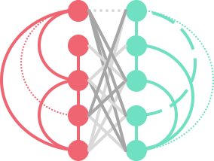
Results
inter sub-genome connections
Sub-network density
Increase connectivity between sub-genomes
Module membership
About twice as many homoeolog pairs became clustered in the same module in alopolyploid
Correlation of node connectivity
Increase correlation between homoeologs
Correlation of functional connectivity
Increased correlation between sub-genomes
Allopolyploidization increases co-expression connections between sub-genomes.
Notes:
To study inter-genome connections, we compared sub-network density between predicted and allopolyploid network, found similar amount of within sub-genome connections, but twice as many connections between sub genome.

Slide 24
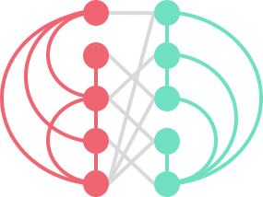
Results
intra sub-genome connections
No global bias of topological change was evident in terms of gain or loss of intra sub-genome connections.
However, asymmetric network topology of duplicated genes was observed.
At
vs
Dt
A₂
D₅
Oil synthesis related gene network
Change of functional connectivity
Increased connections by domestication
TAG synthesis
Biased contribution by D-genome
Transcription factors associated with lipid synthesis
Oil storage
A_{t}-A₂
D_{t}-D₅
Notes:
Next, we compared within sub-genome connections between diploid and polyploid networks, and found …
Remember previously we showed that during cotton seed development, domestication increased regulatory connection of oil storage, TAG synthesis and transcription factor. Looking at connevtivity by sub-genome, this increase is mainly contributed by D genome.
implicating biased recruitment of regulatory architecture.

Slide 25
Presentation
content
Seed development and oil accumulation
How-to and limitations
Topological dynamics by allopolyploidization
Evolutionary dynamics of co-expression network
Construction of duplicated gene networks
Evolution of duplicated gene network
Notes:
I will first talk about our co-expression network analysis focused on cotton seed development and oil accumulation, and then move on to the construction of duplicated gene networks, and finally applying what we have learned to study the dynamics of allopolyploid gene networks.
… hoping to demonstrates how network inference informs our understanding of phenotypic variation that is associated with temporal scales ranging from thousands (domestication) to millions (speciation) of years, and by polyploidy.
And
caveat of our study is that the allopolyploid gene networks were based on the aggregated expression of homoeologous gene pairs.
Further analyses dissecting the interaction or
distinctness of homoeologous modules and networks in polyploid
species will ultimately provide insight into the interaction
among genomes, homoeolog usage in the network, and the
interdependencies of duplicated gene pathways following
polyploidization.

Slide 26
Evolutionary conservation and divergence of gene co-expression networks in Gossypium (cotton) seeds
Co-expression network analysis of developing seeds from diploid and allopolyploid cotton species were conducted to explore network properties associated with seed development and evolution.
Key network modules and functional associations were identified related to seed oil accumulation.
Comparisons among species indicate that network topologies are altered by evolutionary events, including speciation, polyploidy, and cotton domestication.
Domestication strengthens the regulatory connections of oil synthesis and lipid related gene families.
01
Notes:
We conducted co-expression analysis to explore network dynamics associated with developmental process and evolutionary events.
By constructing multspecies network, we were able to identified and functionally annotate key modules of biological feature.
By comparing individual spcies networks, we demonstrated the dynamics of network topology associated with different evolutional event
And at last,
Despite of the insights we gained from this analysis, one caveat I want to point out is that our polyploid gene network is backed on the aggregated expression of homoeolog gene pairs, not seperated homoeolog expresssion. So can we do that?

Slide 27
?
Challenges and pitfalls in the use of partitioned gene counts for homoeologous gene expression and co-expression network analyses
Method choice, genetic features and expression variation of homoeolog gene pairs matter
Small biases are introduced into network inferences
WGCNA out performs binary network approaches
02
01
Notes:
We conducted co-expression analysis to explore network dynamics associated with developmental process and evolutionary events.
By constructing multspecies network, we were able to identified and functionally annotate key modules of biological feature.
By comparing individual spcies networks, we demonstrated the dynamics of network topology associated with different evolutional event
And at last,
Despite of the insights we gained from this analysis, one caveat I want to point out is that our polyploid gene network is backed on the aggregated expression of homoeolog gene pairs, not seperated homoeolog expresssion. So can we do that?

Slide 28
03
Evolutionary dynamics of duplicated gene networks in allopolyploids
Allopolyploidization increases co-expression connections between sub-genomes.
No global bias between the two sub-genomes in terms of gain or loss of edges.
Holds promise for understanding regulatory architecture of complex genomes and phenotypes
02
01
Notes:
We conducted co-expression analysis to explore network dynamics associated with developmental process and evolutionary events.
By constructing multspecies network, we were able to identified and functionally annotate key modules of biological feature.
By comparing individual spcies networks, we demonstrated the dynamics of network topology associated with different evolutional event
And at last,
Despite of the insights we gained from this analysis, one caveat I want to point out is that our polyploid gene network is backed on the aggregated expression of homoeolog gene pairs, not seperated homoeolog expresssion. So can we do that?

Slide 29

More cotton biology
What about duplicated gene networks of fiber development, flowering color variation, day length sensitivity, etc?
From a mechanistic stand point
What are the underlying molecular genetic causes of duplicated network co-regulation?
How are some duplicated modules stitched together, in an expression sense?
…
From an ecological or evolutionary stand point
How are duplicated gene networks shaped by selection to enable adaption or new phenotypes?
…
If the benefit of humankind matters (to us plant people)
How to harness this perspective to crop improvement?
02
01
Notes:
Obviously, this is just a start, but this work raises many fundamental questions. From a mechanistic standpoint...are the underlying molecular genetic causes of duplicated network co-regulation? How are some duplicated modules stitched together, in an expression sense?
Or, if you are coming at this from an ecological or evolutionary point of view, how are duplicated networks shaped by selection to enable adaptation or new phenotypes?
Finally, can we harness this perspective to the benefit of humankind, or to crop plant improvement?
I look forward to the opportunity to discuss these kinds of questions with you during this conference, and even now! Thank you.

Slide 30








Acknowledgement
team and funding
Brigham Young University
Joshua Udall
Justin Page
Agricultural Research Organization, ISRAEL
Ran Hovav
Adi Faigenboim-Doron
Noa Kadmon
Wendel
Lab

Slide 31
Thank you.

